Slide 1
ImageJ scripting Making readable and sharable scripts
2022-11-29
Øyvind Ødegård Fougner

Slide 2

ImageJ – a great way to start with image analysis.
You can do almost every command with a graphical user interface.
You can “record” your action and it will be translated into code.
It is very popular, so there are many functions available.
It has a active forum/helpdesk where challenges are quickly dealt with or corrected

Slide 3
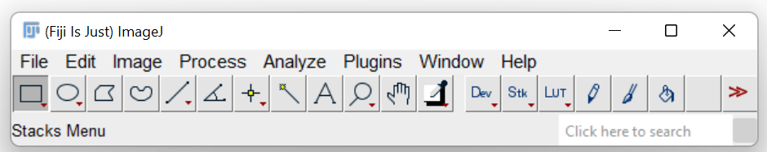
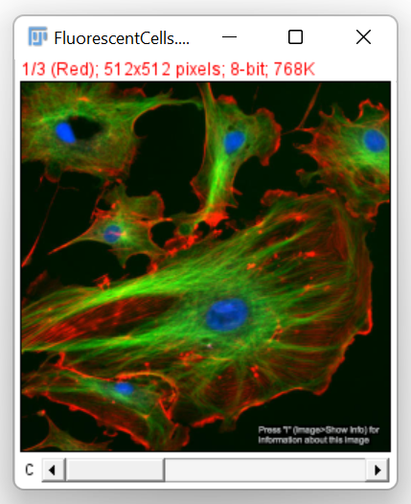
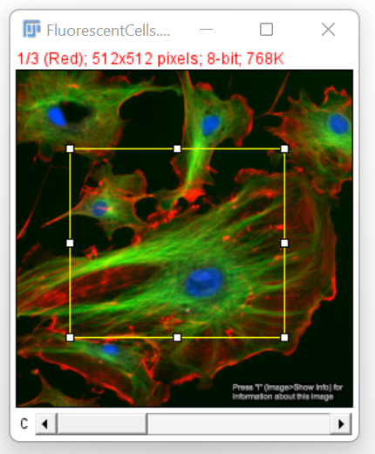
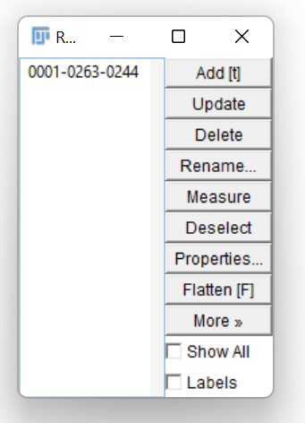
ImageJ at a glance
And
Much
Much
more

Slide 4
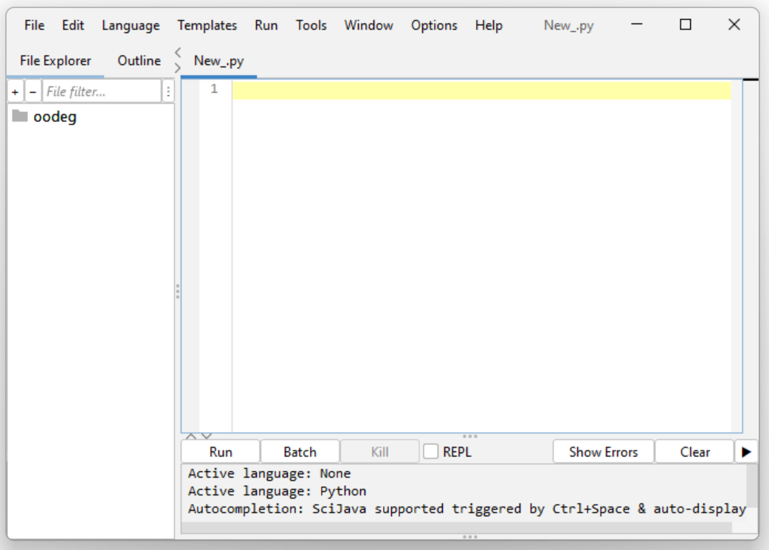
But clicking around in ImageJ quickly becomes tedious and is difficult to reproduce
Script Editor
File/New/Script…
Select language
ImageJ Macro language
“Python” (Jython)
Java
Groovey
Start coding

Slide 5
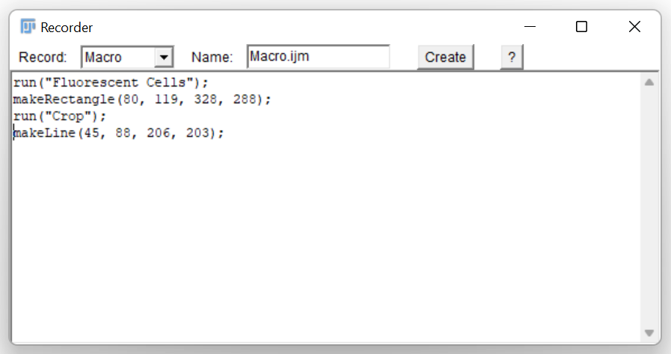
Using the imageJ Recoder
Open the recorder
Plugins/Macro/Record
It will record everything you do in ImageJ
These are ImageJ commands and can be used directly in your script

Slide 6
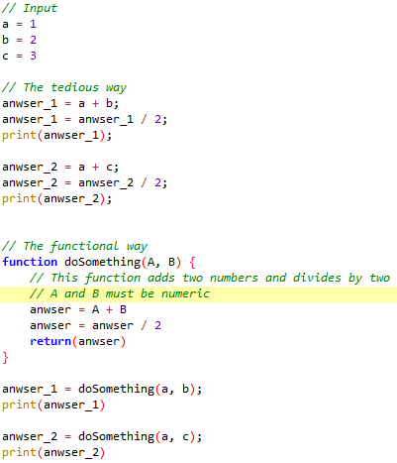
Use functions in your code
Rule of thumb: If more than one line of code is used more than once put it in a function.
It is tedious to repeat code many times
Code with functions are easier to:
Read
Debug
Edit
Share
Re-use
Example 1
Code available at: https://github.com/oodegard/coding_club
Notes:
Ref: https://able.bio/rhett/python-functions-and-best-practices--78aclaa (Rhett Trickett able.bio)

Slide 7
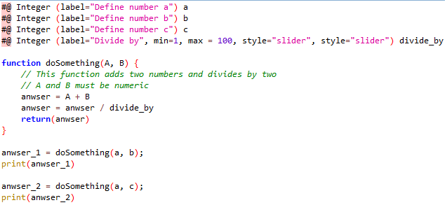
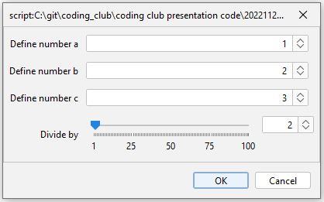
Make your script user friendly by making a graphical user interface (GUI)
#@ script parameters
Simple to use
Clearly defines input
Automatic error handling
E.g. accepts integers only
Easy to use for non-programmers
Can be accessed programmatically
Example 2
Code available at: https://github.com/oodegard/coding_club

Slide 8
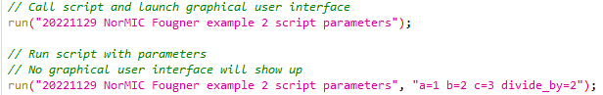
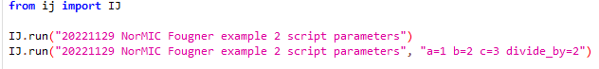
Calling one script from another script
You can re-use your scripts and functions by calling them from other scripts.
Save your code in the imageJ folder called plugins
“C:\ProgramFiles_win\fiji-win64\Fiji.app\plugins”
Re-start ImageJ
Call your script
Example 3
Macro
Python
Code available at: https://github.com/oodegard/coding_club

Slide 9
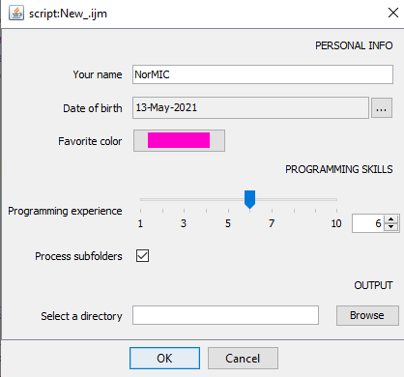
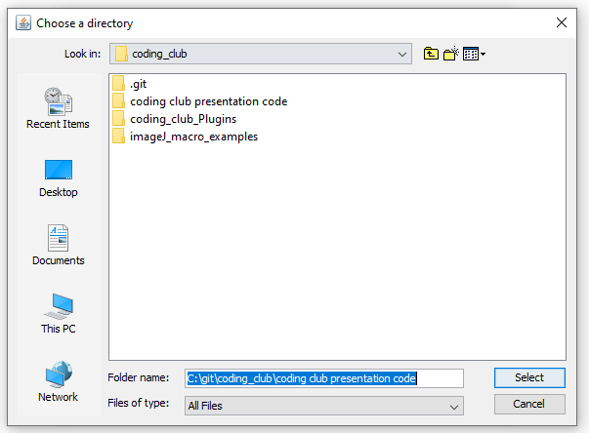
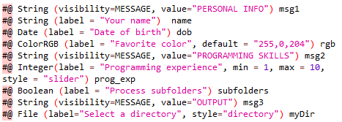
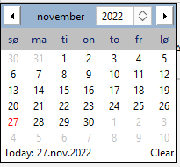
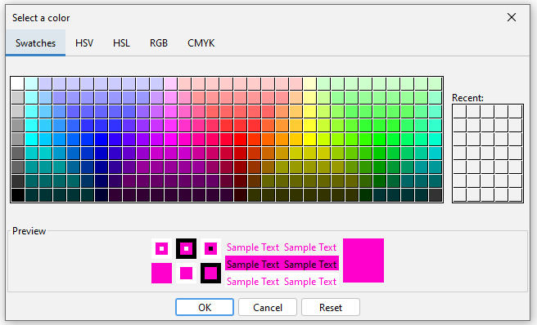
Many types of input
Example 4
RUN
Read more at
https://imagej.net/scripting/parameters
Code available at: https://github.com/oodegard/coding_club

Slide 10
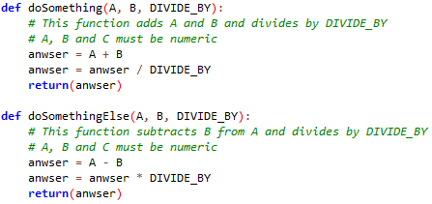
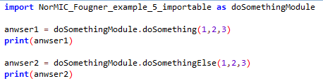
Getting the output from a script you have called
Example 5 (Python)
In the function definition
Save the output as a file
Store the output in a Results table or as an open image
Write python functions and import to main script
Write a proper java library / package (recommended by the community
Save in e.g. “C:\ProgramFiles_win\fiji-win64\Fiji.app\jars\Lib”
Then import and call your functions
Level 1
Level 2
Level 3
Code available at: https://github.com/oodegard/coding_club

Slide 11
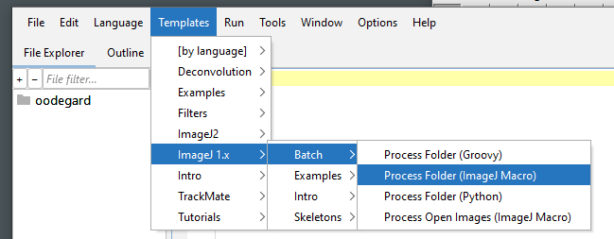
Using existing templates in ImageJ

Slide 12
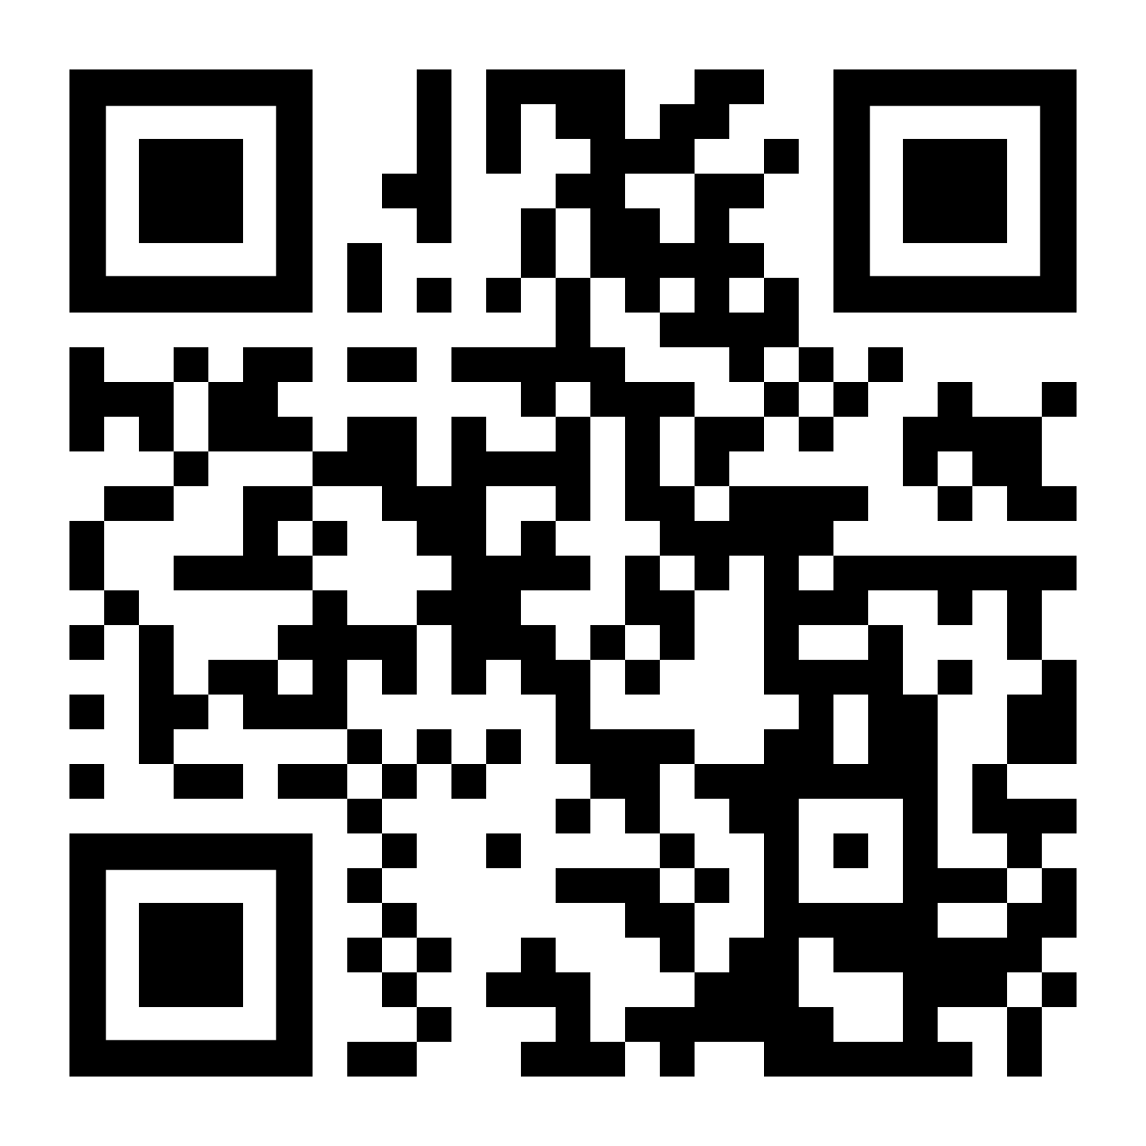
All example code is available online
https://github.com/oodegard/coding_club
In the folder called “coding club presentation code”

Slide 13
How can I re-use my functions in many scripts?
The simple solution is by using
Make your own ImageJ

Slide 14
How I organize my code
Main loop (Workflow)
File management (open/close), Image management (select channel, timepoint etc.), saving of data
Pre-processing
Filters
Annotation
Segmentation
Manual input
Post-processing
Quantification
Adjusting manual input
Manual QC
Cropping

Slide 15
Each function could be stored as a separate macro if you use it often
Main loop (Workflow)
File management (open/close), Image management (select channel, timepoint etc.), saving of data
Pre-processing
Filters
Annotation
Segmentation
Manual input
Post-processing
Quantification
Adjusting manual input
Manual QC
Cropping

Slide 16
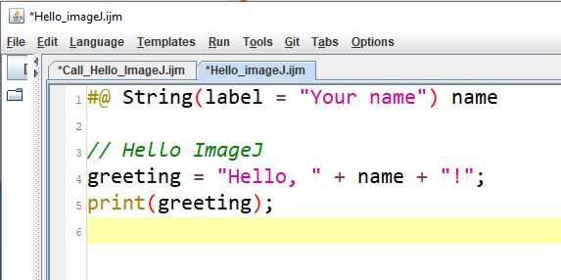
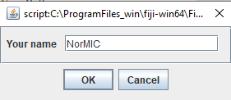
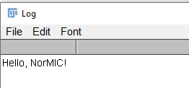
Using #@ Script parameters to communicate with the user, and with other macros
A simple way to define input variables in ImageJ
A simple way to make a graphical user interphase
Hello ImageJ example
Input dialogue
Output print
https://github.com/oodegard/imageJ_ScriptParameters
https://imagej.net/Script_parameters

Slide 17
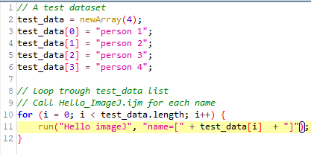
You can call other macros from a macro
Hello_ImageJ.ijm
The “Hello imageJ” macro can then be called from any macro you write.
Your main program loop becomes less complicated.
If you find a mistake in your “Hello imageJ” macro you only need to edit it one place.
You can even call Hello imageJ from macros written in different languages!
Call_Hello_ImageJ.ijm
Output:
Hello, person 1!
Hello, person 2!
Hello, person 3!
Hello, person 4!
https://github.com/oodegard/imageJ_ScriptParameters
https://imagej.net/Script_parameters

Slide 18
Example

Slide 19
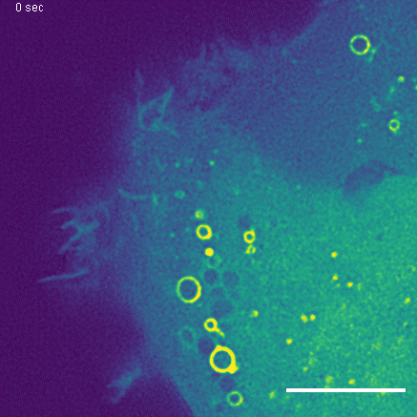
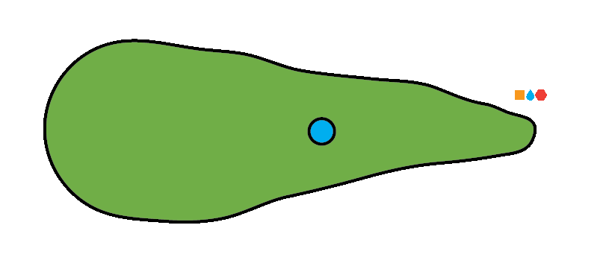
Macropinocytosis – The cells way of drinking and sampling the environment
Cell membrane ruffles
Encapsulation of extracellular liquid and cargo
Vesicle formation
Diameter: 0.2 – 5µm
Intracellular translocation
Scale 10 µm

Slide 20
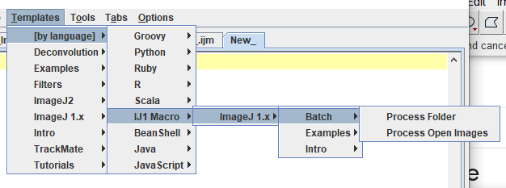
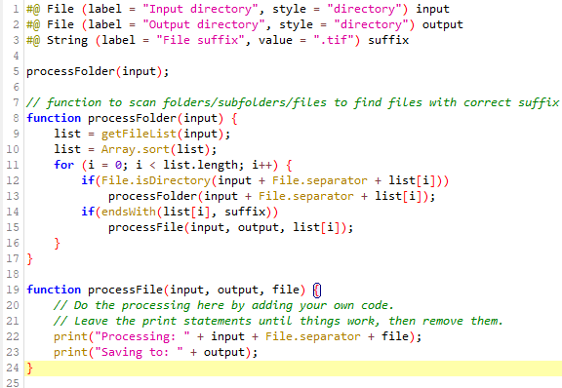
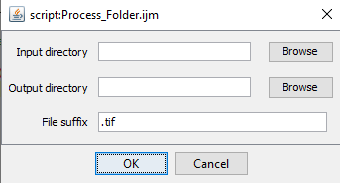
ImageJ macro template to process all files in a folder
RUN
https://github.com/oodegard/imageJ_ScriptParameters

Slide 21
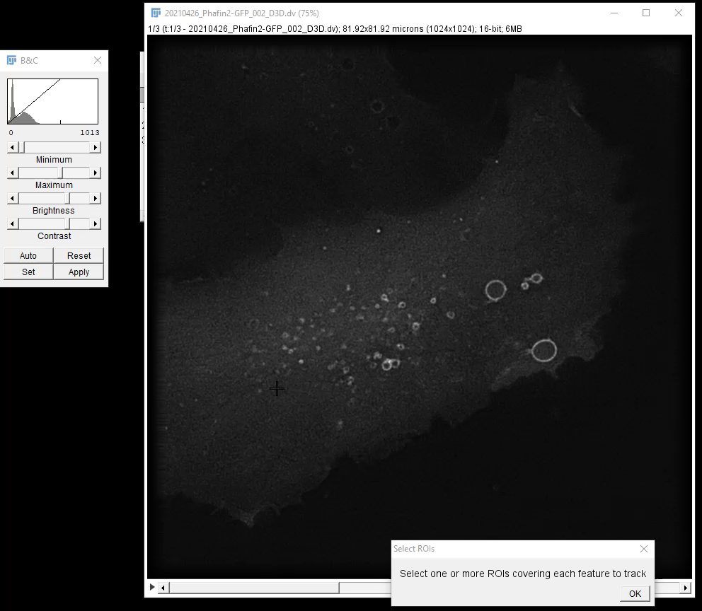
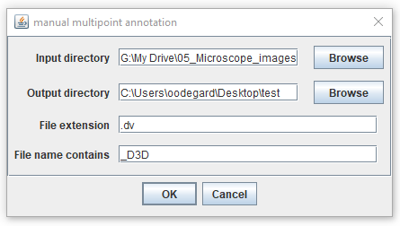
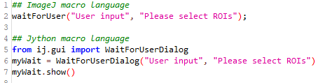
Manual multipoint annotation macro
Loop over all images in a folder
Pre-processing
Ask user to annotate tracks
Save user annotation
https://github.com/oodegard/imageJ_ScriptParameters

Slide 22
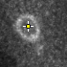
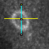
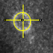
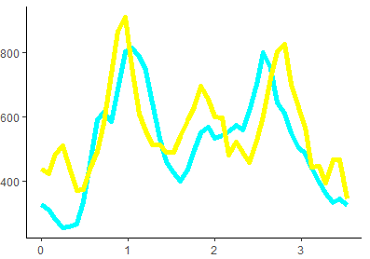
Post processing of tracked particles
Manual point
selection
Line profiles
Oval roi
Program outline
Automatic file opening
Manual input/selection
Humans do difficult segmentation quickly
Automatic post processing
Adjust manual selection to centre
Find centre of vesicle
Make oval
Quantify
Automatic saving
Intensity (A.U.)
x

Slide 23
Data and code structure
Some examples of what to do and what not to do
Notes:
Korbin Michael talk

Slide 24
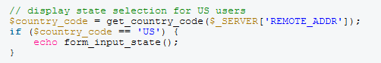
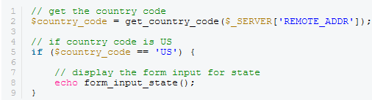
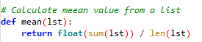
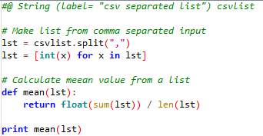
Make your code readable and re-usable
Document your code
DO: Make descriptive comments
DON’T: Make obvious comments
Limit line length
Use functions instead of repeating code
Save useful functions as separate macros with Script Parameter input

Slide 25
How to organize your microscopy images
Good practice
Bad practice
Use a consistent folder structure in all your experiments
Experiment ID / Date
What is imaged
Use a consistent file name structure in all your experiments
Experiment ID / Date
What is imaged
Using generic image/folder names
Image 1, image 2, … image N
Not having any info about your experiment either in your lab notebook or with your image files
If you are looking for a file 2-3 years later, could you find it?, could you have used it in a publication?

Slide 26
Could you re-analyze an experiment that you analyzed a year ago and get the same answers?
Save which version of code that was used for processing
Use a parameter file
Contains all input variables
Is saved with the output of code
Contain date and code version
Or save input parameters
You might get a request to re-process your data, or include new data to your output.
Could you do that 2-3 years after you ran your code?

Slide 27
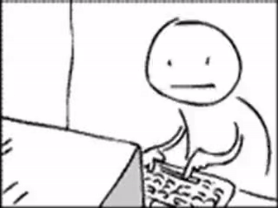
Summary
Organize your code in discrete segments
Use #@ Script Parameters for input
Split code into functions, or separate macros rather than making copies of it
Have a data management plan
Have a code management plan
Make sure that you can reproduce your work
Stay sane
gfycat.com

Slide 28
Thank you for listening
Have a good weekend!!!

Slide 29
How I organize my code?
One macro to do it all
Main macro calls specialized macros
For each image:
Gaussian blurring
Manual user input
Saving annotations
Simple to write
Simple to distribute
Difficult to troubleshoot
Specific to one task
For each image:
Call pre-processing macro
Call segmentation macro
Call quantification macro
Save results
Each macro has its clear purpose
No copying of code from macro to macro
Can become “too” complicated
Macros need to communicate
✓
✓
X
X

